Slide 1
INVESTMENT CASE STUDY SUBMISSION
Manish Kumar

Slide 2
Investment Data Analysis
Understand Real Investment Data from crunchbase.com
Find out best investment strategy for Spark Funds
Constraints:
5 to 15 million USD per rounds of investment
English Speaking Countries

Slide 3
Methodology Followed
Calculate the funds raised by funding types.
Filter the funding type which raised the most significant amount.
Filter the funding type meeting constraint as well. ( 5 to 15 million USD).
Filter top countries with English as their official language.
Find out top main sectors to invest in these countries
Arrive at a decision.

Slide 4
Analysis
Query | Findings
Total unique companies present in data | 66368
Average funding amount of venture type (in USD) | 11748949.1
Average funding amount of angel type (in USD) | 958694.5
Average funding amount of seed type (in USD) | 719818
Average funding amount of private equity type (in USD) | 73308593
Funding type meeting our constraint of investment 5 – 15 million USD | venture

Slide 5
Analysis
Query | Findings
Top English speaking country | USA
Second English speaking country | GBR
Third English speaking country | IND

Slide 6
Sector Wise Analysis
Query | USA | GBR | IND
Total number of Investments (count) | 9942 | 559 | 243
Total amount of investment (USD) | 88638294664 | 4875228300 | 2174543602.0
Top Sector name (no. of investment-wise) | Others | Others | Others
Second Sector name (no. of investment-wise) | Social, Finance, Analytics, Advertising | Cleantech / Semiconductors | Social, Finance, Analytics, Advertising
Third Sector name (no. of investment-wise) | Cleantech / Semiconductors | Social, Finance, Analytics, Advertising | News, Search and Messaging
Number of investments in top sector (3) | 2423 | 129 | 78
Number of investments in second sector (4) | 2216 | 124 | 45
Number of investments in third sector (5) | 1951 | 118 | 41
For point 3 (top sector count-wise), which company received the highest investment? | 128-TECHNOLOGY | ACS-CLOTHING | 21DIAMONDS-INDIA
For point 4 (second best sector count-wise), which company received the highest investment? | SPECTRUM-BRIDGE | ROOTSTOCK-SOFTWARE | AZURE-HOSPITALITY

Slide 7
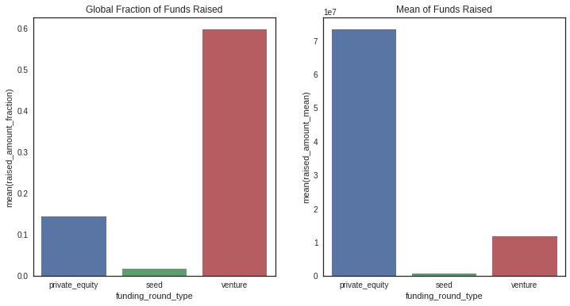
Fracction of total investment globally in seed, venture and public_equity and average amount of investment in each funding type

Slide 8
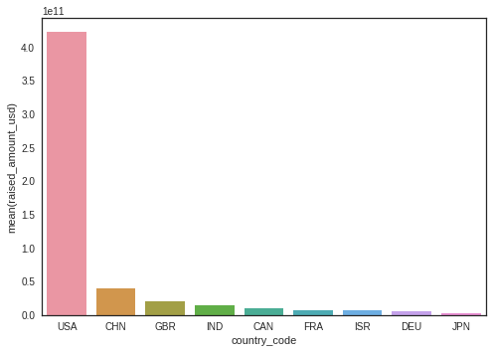
Top 9 countries against the total amount of investments of Funding type

Slide 9
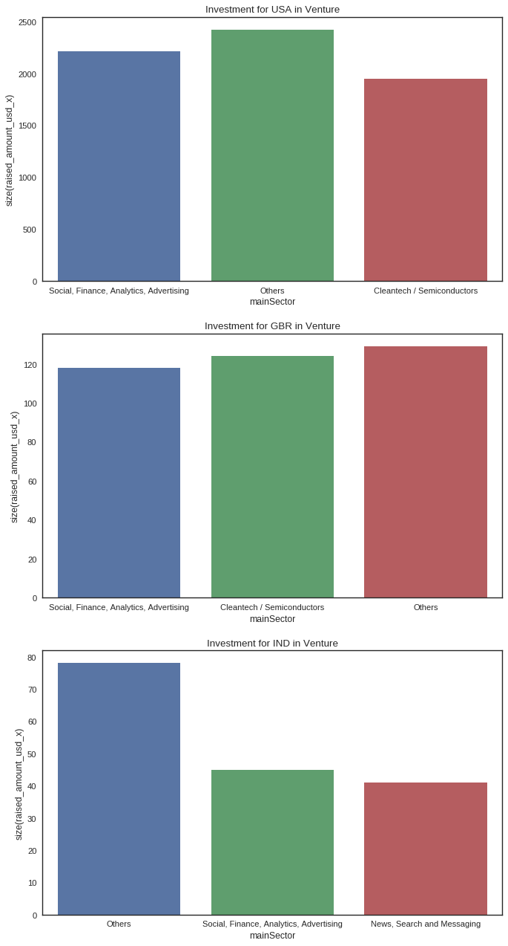
Plot showing no. of top3 sectors in top3 countries

Slide 10
Conclusions
Spark Funds can distribute its investment into these countries and companies
128-TECHNOLOGY - USA
ACS-CLOTHING - USA
21DIAMONDS-INDIA - GBR
SPECTRUM-BRIDGE - GBR
ROOTSTOCK-SOFTWARE - IND
AZURE-HOSPITALITY - IND

